Slide 1
K-12 Learning Acceleration Grant
Ynez Peterson
ypeterso@odu.edu
Dr. Ray Heipp
rheipp@schoolhealth.com
www.schoolhealth.com
Gary Tilbe
gary@logantech.com
www.logantech.com

Slide 2
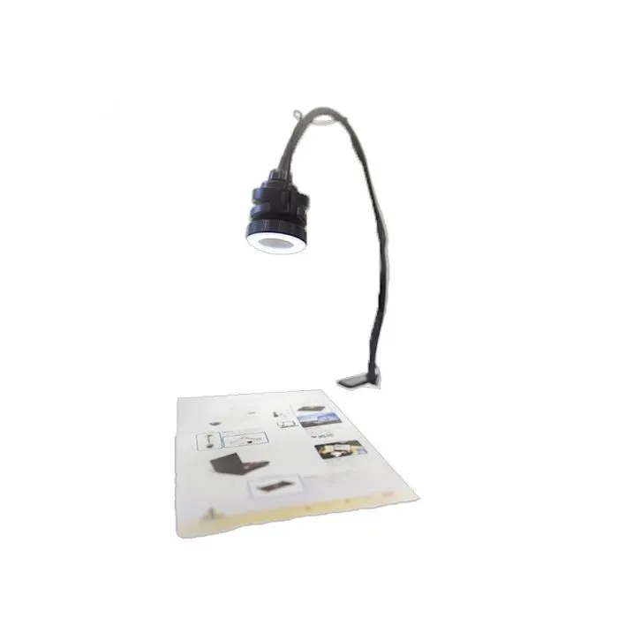
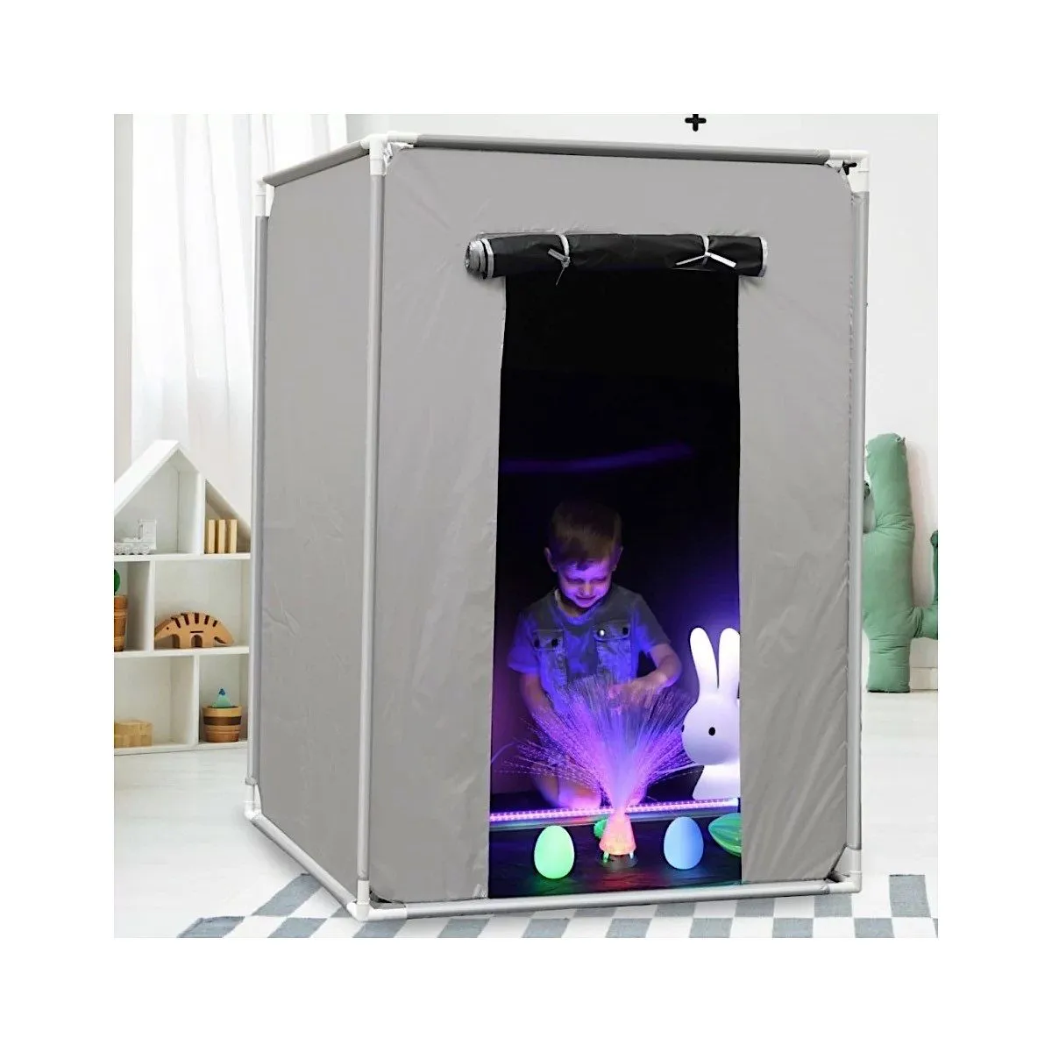
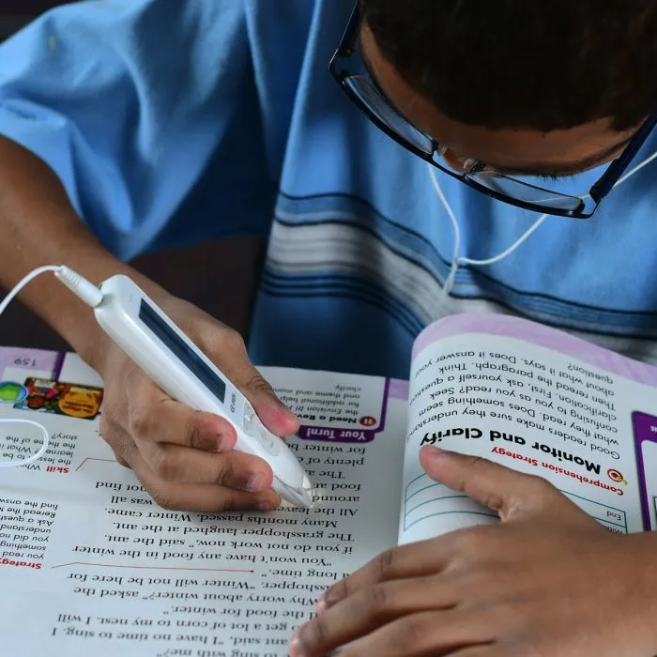
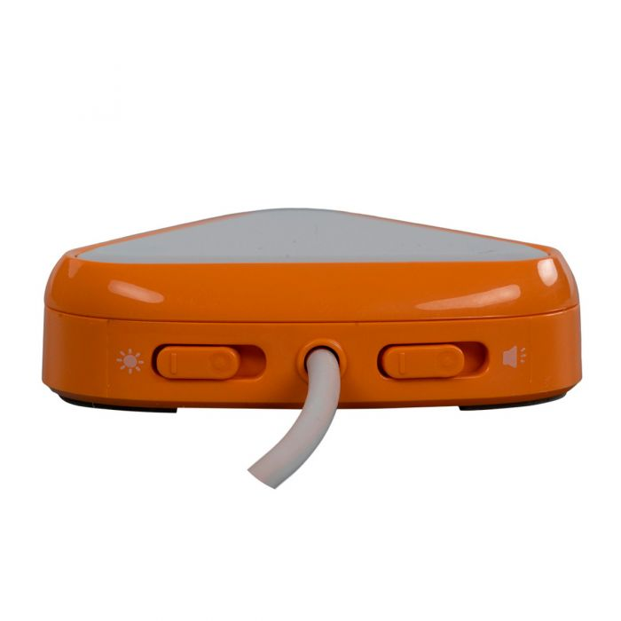
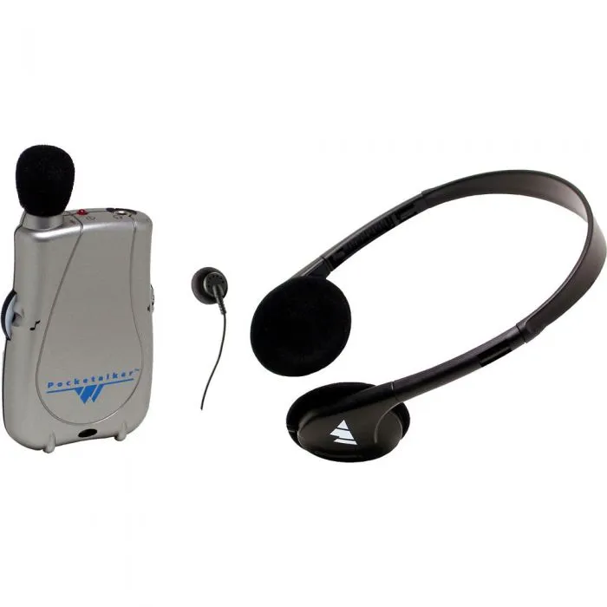
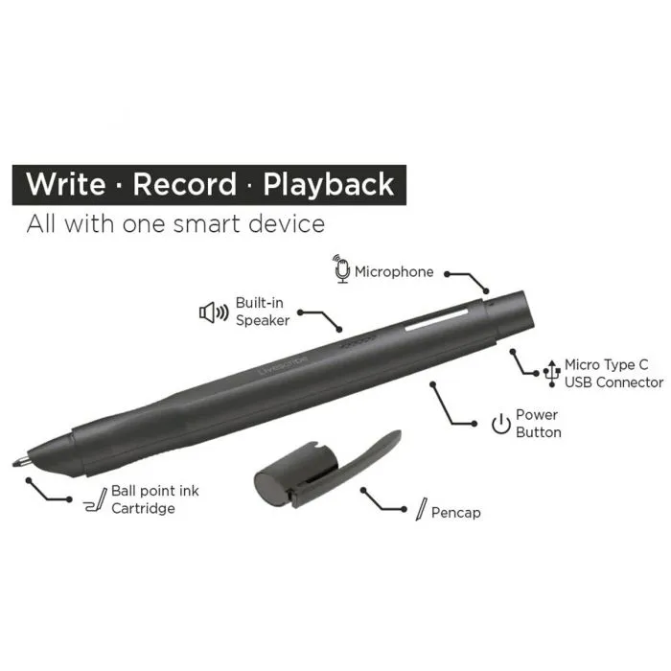
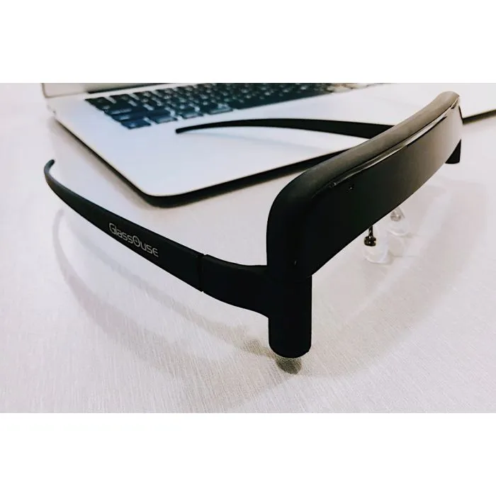
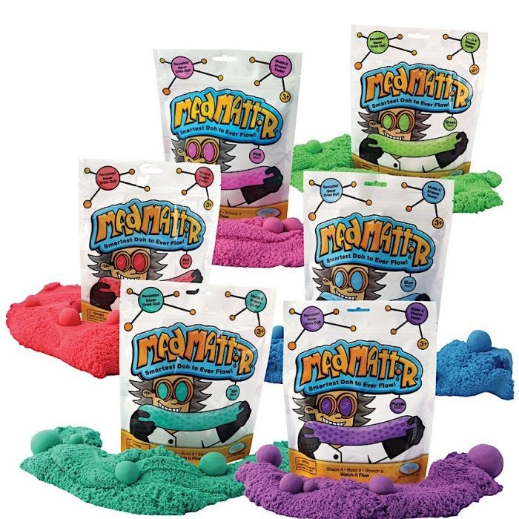
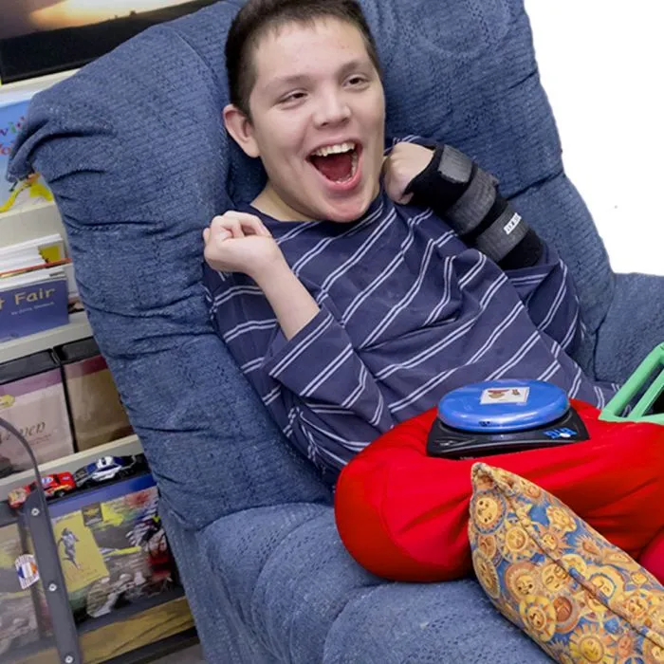
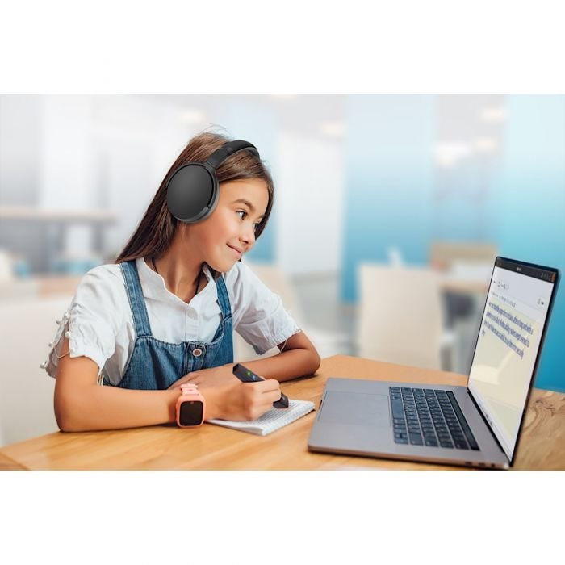
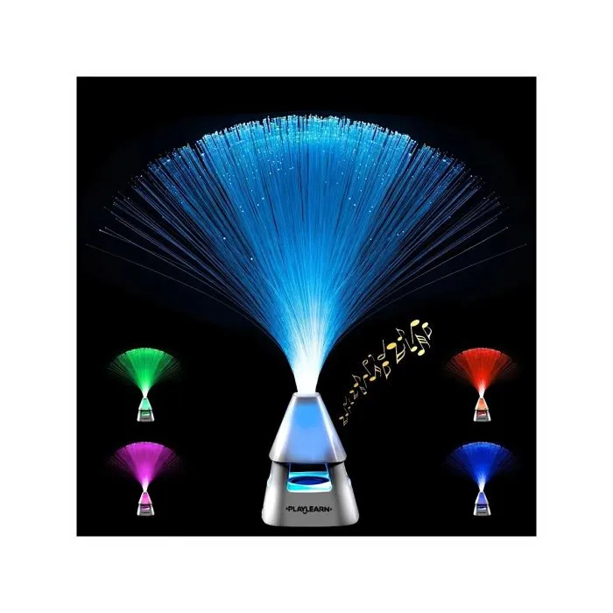
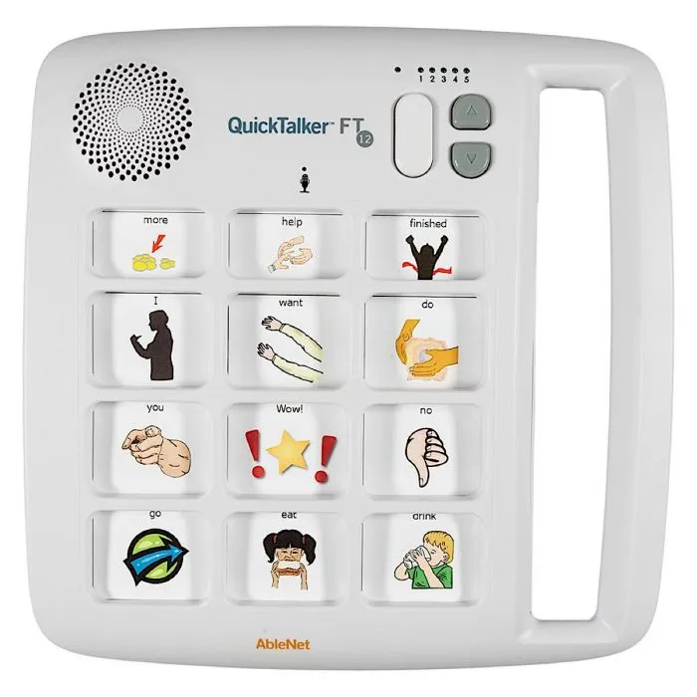
Think this way for our individuals: Literacy – Access - Sensory

Slide 3
Direct Links
Literacy
Sensory
School Health C-Pen Reader 2
School Health Mad Mattr Modeling Dough
School Health Scanmarker Reader
School Health Square Vibrating Pillow
School Health Livescribe Echo 2 Smartpen
School Health Fiber Optic Lamp with Wireless Speaker
Access
School Health AbleBaby USB Camera With Table Mount
School Health Pocketalker Ultra Personal Amplifier
School Health GlassOuse Hands-Free Assistive Mouse
School Health QuickTalker FT 12
School Health AbleNet Talking Brix 2
School Health AbleNet LITTLE Candy Corn 2 Proximity Switch
School Health AbleNet BIGmack Communicator

